Slide 1
Python Basics
Let’s get into the first class!

Slide 2
CONTENTS
This is a the main contents of today’s class.
We will learn the following during today’s class.
Using Google Colab | How to use Google Colabatory
Printing in Python | Print simple sentences and your names
Data types and Variables | Get different types of data and store them into variables
Operators | Logical, arithmetical operators
List, dictionary, tuple | Different types of collection of data
Function | A block of code that has a particular function

Slide 3
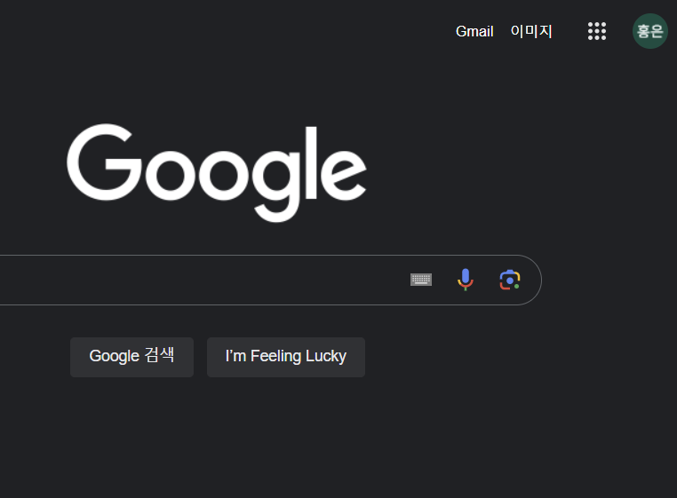
How to use Google Colab

Slide 4
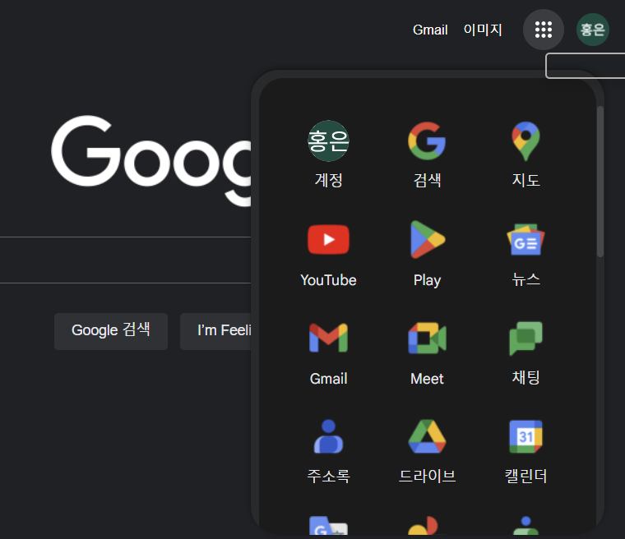
How to use Google Colab

Slide 5
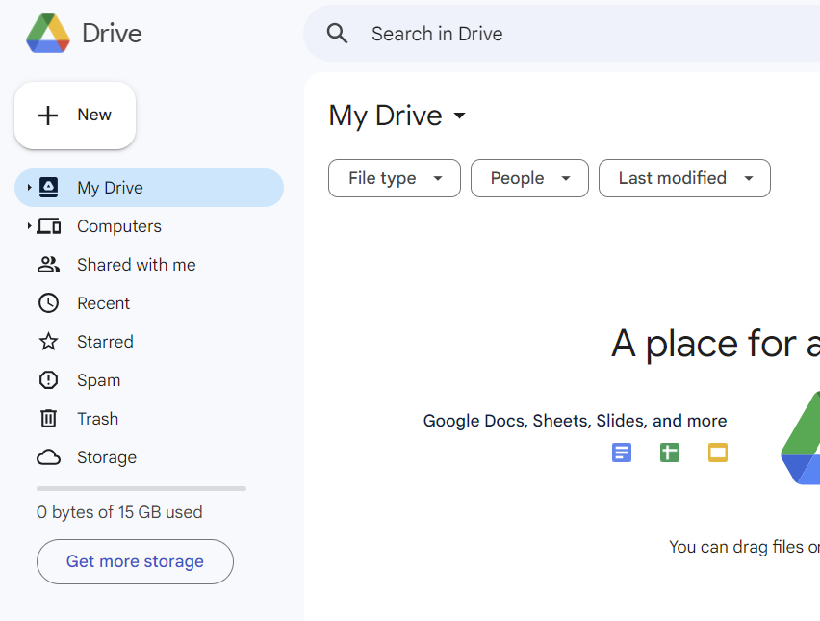
How to use Google Colab

Slide 6
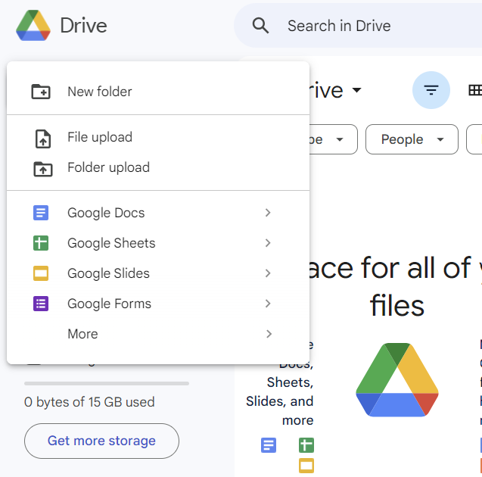
How to use Google Colab

Slide 7
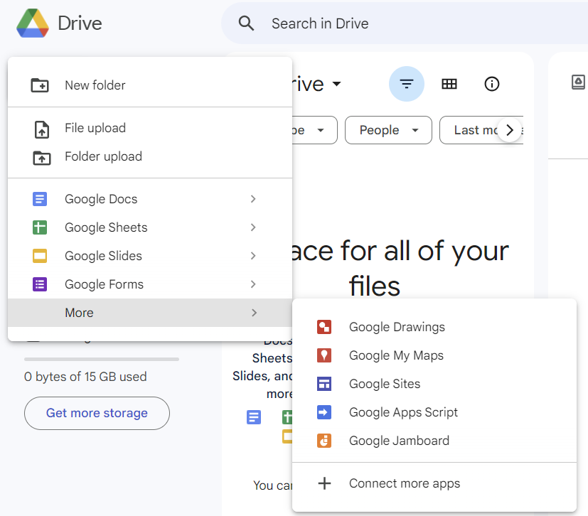
How to use Google Colab

Slide 8
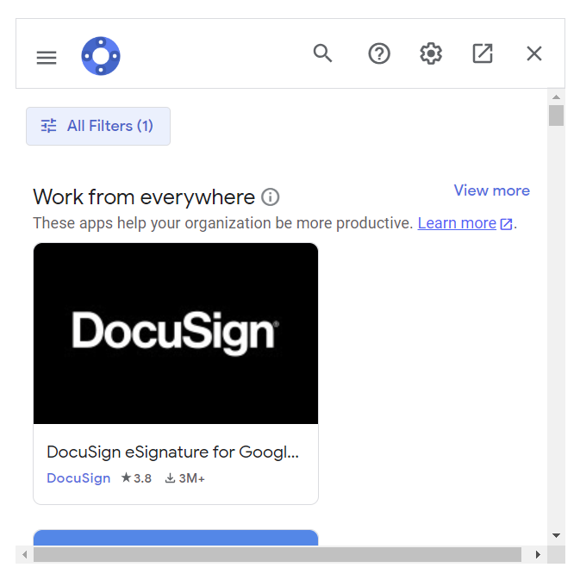
How to use Google Colab
Colaboratory

Slide 9
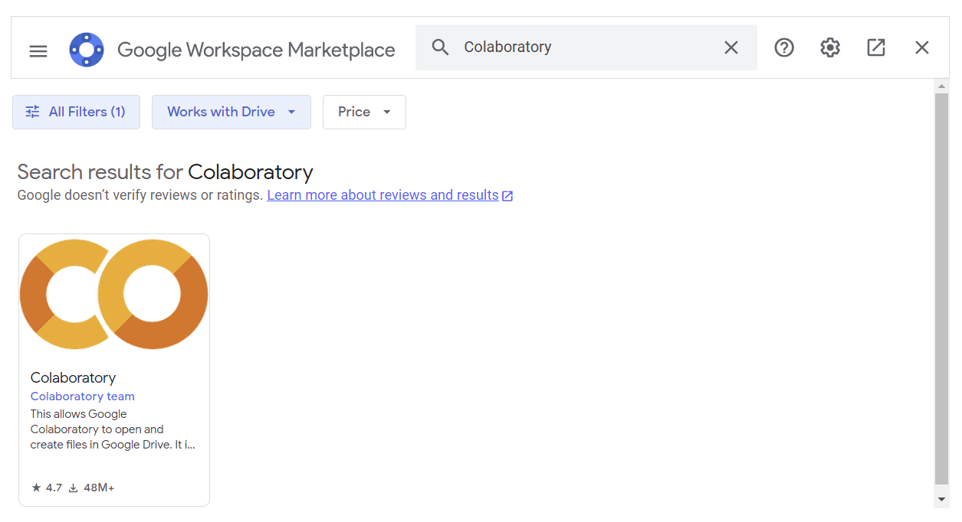
How to use Google Colab

Slide 10
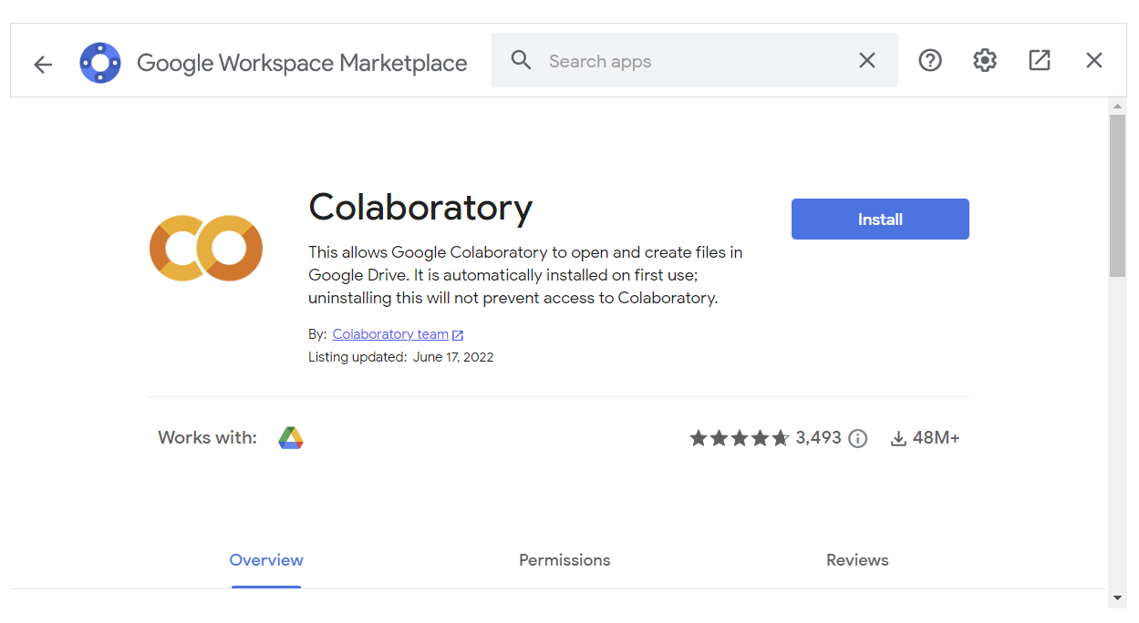
How to use Google Colab

Slide 11
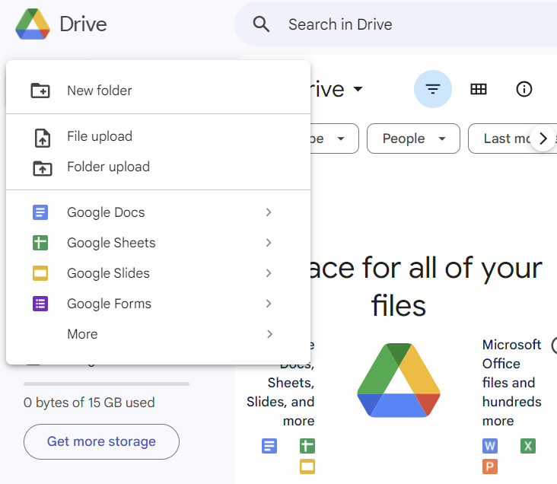
How to use Google Colab

Slide 12
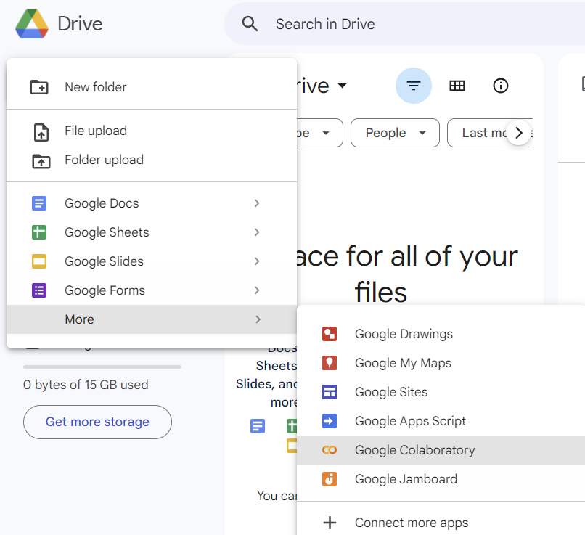
How to use Google Colab

Slide 13
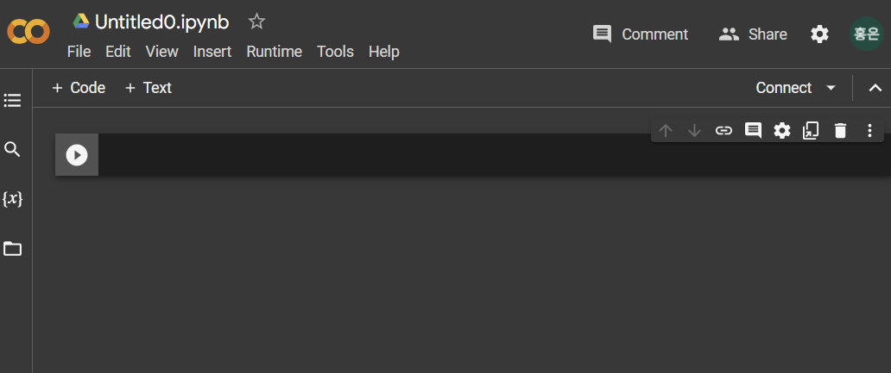
How to use Google Colab
your file name
click to add a new code block
Write your code here!

Slide 14
Printing in Python
This is how to print sentences
The print() function prints the value or data
This function prints the input data in order, with blank spaces to divide each others
print(“Hello, World”) print(1, 2, 3) | This line is to print “Hello, World” This line prints 1 2 3 in order with blank spaces between.

Slide 15
Printing in Python
Now, try printing your name!

Slide 16
Data Types and Variables
There are different data types such as int(integer), float, str(string), bool(boolean)
“int” type stores integers such as 1, 2, 3, 4, …
“float” type stores floating point numbers such as 2.1, 3.4, 6.589
“str” type stores strings(text) such as words, sentences, …
“bool” types stores Boolean data types(True or False)
To know which data type something is, use type() function
print(type(“Hello”)) print(type(1)) | Type function prints the input data type

Slide 17
Data Types and Variables
Variables are where you can store different types of data.
Numbers are not allowed for the first part of the variable name.
Only alphabets and numbers, underscores(_) are allowed.
a_number1=10 b_string1=“apple” print(a_number1, b_string1) | Stores 10 in a(a becomes int type) Stores “apple” in b(b becomes str type) Prints: 10 apple

Slide 18
Data Types and Variables
Now, print your age and name!

Slide 19
Data Types and Variables
Try to execute the following!
type(True) type(4.9) | Prints: type<“bool”> Prints: type<“float”>
c=False d=3.14 print(c, d) | Stores False in a(a becomes bool type) Stores 3.14 in b(b becomes float type) Prints: False 3.14

Slide 20
Data Types and Variables
Now, print your height in this format!
Format: My height is 165.

Slide 21
Data Types and Variables
You can even store user-entered data in variables
a=input() print(a) | Stores user-entered data in a(a becomes str type) Prints the data user entered.

Slide 22
Data Types and Variables
The input() function always receives string data type.
To get other types of data use int(), float()
my_input=input() print(type(my_input)) | Even if you write integers or floating point numbers, it will receive them as strings.
b=input() b=int(b) print(b, type(b)) | Stores user-entered data in b b becomes type int(causes error if b cannot be changed to int) Prints the data user entered.
b=int(input()) print(b) | Does the same thing as above.

Slide 23
Operators
Python can calculate basic operators.
print(2+5) print(2*5) print(2-5) print(2/5)
print(32//5) print(32%5) | Floor division. The result is the quotient Remainder operation.

Slide 24
Operators
Try executing the following.
b=input() print(b*2) | Input value: 3 Prints the string twice.
b=int(input()) print(b*2) | Input value: 3 Prints 3 multiplied by 2.

Slide 25
Operators
Try to get two numbers and print the sum, multiplication, subtraction and division
Ex) input: 2 3
Output: 5 6 -1 0.666

Slide 26
Operators
Try to print the quotient and remainder of 61 divided by 7 in this format.
Ex) Output: 61%7=8∙∙∙5

Slide 27
Operators
Logical operators are widely used in computers.
The “or” operator results TRUE if 1 or more input data is TRUE.
The “and” operator results TRUE only if all of the input data is TRUE.
The “not” operator results in the exact opposite(TRUE or FALSE) of the whole data.
Nonzero values such as 1, 100 means TRUE in logical operations.
Zero(0) means FALSE in logical operations.
x₁ | x₂ | y(x₁ or x₂)
1 | 1 | 1
1 | 0 | 1
0 | 1 | 1
0 | 0 | 0
x₁ | x₂ | y(x₁ and x₂)
1 | 1 | 1
1 | 0 | 0
0 | 1 | 0
0 | 0 | 0
x | not x
1 | 0
0 | 1

Slide 28
Operators
Try executing the following code.
print(True or True) print(True or False) print(False or True) print(False or False)
print(True and True) print(True and False) print(False and True) print(False and False)
print(not True) print(not False) print(not True or True) print(not(True or True))

Slide 29
Conditions
We can also make programs do things in certain conditions. When using the condition statements, we can use signs like equality(==), bigger than(>), less than(<), bigger than or equal to(>=), less than or equal to(<=)
*You should differentiate = and ==. = is storing the right value to the left value, and ==is checking if both sides are same.
a=10 print(a==10) print(a<10)

Slide 30
Conditions
We can use the if, else statement. When using the if else statement, the line including the condition should have colon(:) at the end. Also, the execution block should be indented with the same extent.
a=10 if(a==10): print(“a is equal to 10”) else: print(“a is not equal to 10”) | Executes the following indented block if a is equal to 2 Indented block. Prints “a is equal to 10” Executes the following indented block if the above condition is false. Indented block. Prints “a is not equal to 10”

Slide 31
Conditions
Now, try to make a program that allows only people with age 20 to 35 to enter.
Ex) input: 23
Output: You can enter
Input: 39
Output: You cannot enter

Slide 32
Iteration(while)
We can also make programs repeat things in certain conditions. When using iteration, we can also use signs like equality(==), bigger than(>), less than(<), bigger than or equal to(>=), less than or equal to(<=)
We can use the while statement. When using the while statement, the line including the condition should have colon(:) at the end. Also, the execution block should be indented with the same extent.
Increase, continue, break
a=10 while(a<10): print(“value of a is ”, a) a=a+1 | 단축키 Repeats the following indented block if a is smaller than 2 Indented block. Prints “value of a is ” and the value of a Store value of a+1 in a.(same as a+=1)

Slide 33
Iteration(for)
“for” is a convenient way of repetition. It repeats the indented block with some rule.
The following two codes do the same thing.
a=0 while(a<10): print(“value of a is ”, a) a=a+1 | Repeats the following indented block if a is smaller than 2 Indented block. Prints “value of a is ” and the value of a Store value of a+1 in a.(same as a+=1)
for a in range(0, 10, 1): print(“value of a is ”, a) | Initial value of a is 0. while a<10. increment a by 1 Indented block. Prints “value of a is ” and the value of a

Slide 34
Iteration(for)
continue: goes to the next iteration
break: stops the iteration
for a in range(0, 10): if a%3==0: continue print(a) | Same as for a in range(0, 10, 1) Skips numbers that can be divided with 3 Prints the value of a
for a in range(0, 10): if a%3==0: break print(a) | Same as for a in range(0, 10, 1) Stops printing value of a if a can be divided by 3

Slide 35
Iteration
Now, try to make a program that prints the multiplication of the input number.(Use while or for)
Ex) input: 2
Output: 2X1=2
2X2=4
2X3=6 …

Slide 36
Iteration
You can also use for loops in for loops.
for a in range(0, 10): for b in range(0, 10): print(a, b) | While value of a is 0, b changes from 0 to 9

Slide 37
Iteration
Now, try to make a program that prints numbers in this order
Ex) output:
1 2 3 4
8 7 6 5
9 10 11 12

Slide 38
Iteration
Now, try to make a program that prints if the input number is a prime number!
Ex) input: 7
output: This is a prime number

Slide 39
List
List is ordered collection, where you can store multiple values using one variable.
It allows duplicated items inside.
numbers = [1, 2, 3, 4, 5] different_list = [1, "hello", 3.4, True] nested_list = [1, [2, 3], 4] | Makes a list with elements 1, 2, 3, 4, 5 Elements can be different types Lists can be an element in a list

Slide 40
List
Get the values in a list by the index.
The first value’s index is 0, second is 1, third is 2, and so on.
If there is no value in the index, an error occurs.
numbers = [4, 2, 6, 10, 3] print(numbers[0]) print(numbers[3]) print(numbers[5]) | Makes a list with elements 4, 2, 6, 10, 3 Prints the first value, which is 4 Prints the fourth value, which is 10 Occurs an error because there is no sixth value in the list.

Slide 41
List - methods
You can get the number of elements in the list with len() method
my_list = [1, 2, 3, 4, 5] len(my_list) | Makes a list with 5 values Returns 5

Slide 42
List - slicing
You can access the elements of the list by the range of index.
The format is name_of_list[start, end, step]. The end index is not included, and the step implies how much the index will increase every time.
my_list = [1, 2, 3, 4, 5] my_list[0:2] my_list[:2] my_list[2:5] my_list[3:] my_list[1:-2] my_list[0:5:2] my_list[::-1] | Makes list Returns [1, 2] Same as [0:2] Returns [3, 4, 5] Same as [4, 5] -2 means up to second last element Returns the first, third, fifth element Returns [5, 4, 3, 2, 1]

Slide 43
Slicing for string
You can also use slicing for string.
sample_string = "hello world" print(sample_string[2]) print(sample_string[0:5:2]) print(sample_string[::-1]) | Make string Prints “l” Prints “hlo” Prints “dlrow olleh”

Slide 44
Slicing for string
A palindrome is a word that is the same back and forth, like ‘level’, ‘racecar’.
Make a program that checks if the input word is a palindrome.

Slide 45
List - mutation
You can change the value of the list, which means lists are mutable.
You can replace or remove elements in the list, and also add elements to the list.
my_list = [1, 2, 3, 4, 5] my_list[3] = 100 my_list | Makes list Replaces the fourth value with 100 Returns [1, 2, 3, 100, 5]
my_list.append(6) my_list.append(7) my_list.append(8) my_list | Returns [1, 2, 3, 4, 5, 6, 7, 8]
my_list.remove(1) my_list | Removes the element with value 1 Returns [2, 3, 4, 5, 6, 7, 8]
my_list.pop(3) my_list | Removes the element with index 3 Returns [2, 3, 5, 6, 7, 8]

Slide 46
List
Make empty list.
Then receive 3 scores and take them in list as int.
Finally calculate average score.

Slide 47
Bonus: list comprehension
Make list inline
[value for ~ in ~]
scores = [int(input) for _ in range(3)] (scores[0] + scores[1] + scores[2]) / 3

Slide 48
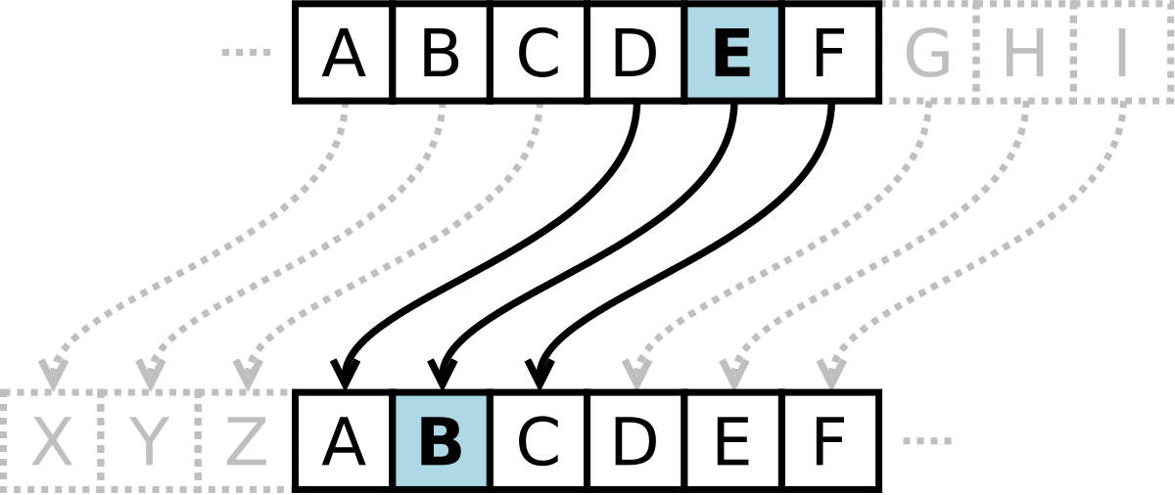
List
Caesar cipher is an encrypting method. Try to implement Caesar cipher with list comprehension and join() function.

Slide 49
Dictionary
Dictionaries are key-valued collection.
It has no index but key.
Dictionaries can have any types of key and any types of value
my_dict = {"name": "John", "age": 26, "height": 180} print(my_dict['name']) print(my_dict['age']) print(my_dict['height']) | Make dictionary with {key: value} pair Prints “John” Prints 26 Prints 180
{True: False, 2: 3, 3.5: "hello", "world": [1, 2, 3]}

Slide 50
Dictionary
keys returns keys of the dictionary
my_dict = {"name": "John", "age": 26, "height": 180} my_dict.keys() | Make dictionary dict_keys(['name', 'age', 'height'])

Slide 51
Dictionary
values returns values of the dictionary
my_dict = {"name": "John", "age": 26, "height": 180} my_dict.values() | Make dictionary dict_values(['John', 26, 180])

Slide 52
Tuple
Tuple is immutable list
my_tuple = (1, 2, 3, 4, 5) print(my_tuple[0]) print(my_tuple[1:3]) | Make tuple 1: Indexing (2, 3): Slicing

Slide 53
Function
Function is a block of code which is executed when it is called.
Function makes the code reusable
def add(a, b): return a + b added_value = add(37, 42) another_added_value = add(21, 17) final_added_value = add(added_value, another_added_value) | Function header Function body Call function Call function Call function

Slide 54
Function
You can return multiple values
def operation(a, b): return a + b, a - b, a * b, a / b add, sub, mul, div = operation(37, 42) print(add, sub, mul, div) | Function header Function body Call function, return value type is tuple

Slide 55
THANKS
Do you have any questions?
im.hongeun@gm.gist.ac.kr

